Slide 1

Division of Biology and Biomedical Sciences - Washington University in St. Louis

Slide 2
Who are we????
Introductions

Slide 3
What is a Graduate Student?
High School 4 years
College 4 years
Graduate School 5-6 years

Slide 4
What do you do as a Graduate Student in Science?
Experiments
Outreach
Life as a Graduate Student
Design and conduct new science experiments to add knowledge to the science field
Teach others through science outreach programs or by assisting in courses
Get paid to be a student
Healthcare insurance included
Interact with professors outside of classes
Visit other countries by participating in conferences
Publish your findings in journals (become authors!)

Slide 5
How do you become a Graduate Student?
High School 4 years
College 4 years
Graduate School 5-6 years
You should participate in different programs such as:
Young Scientist Program – Summer Focus
Saint Louis Science Center – YES program
Nature Works – Forest Park Forever
Shaw Institute for Field Training (SIFT) and Tyson Environmental Research Fellowships (TERF)
College Bound
Saturday Scholars
Bridge Program – UMSL
Apply to college – senior year (pick a college that is strong in the sciences but is the right fit for you!)

Slide 6
How do you become a Graduate Student?
You should:
Intern in a science lab – contact a professor starting freshman year
Apply for Mellon Mays Fellowship – sophomore year if available at your school
Declare a major in a science field – sophomore year
Conduct an independent research project – starting junior year
Apply for National Science Foundation Graduate Fellowship senior year – senior year
Take the Graduate Record Examination (GRE) - senior year
Apply to graduate school – senior year
High School 4 years
College 4 years
Graduate School 5-6 years

Slide 7
How do you become a Graduate Student?
High School 4 years
College 4 years
Graduate School 5-6 years
You should:
Continue to work hard
Choose a lab that is interesting to you
Choose an advisor that you feel comfortable working with

Slide 8
What do you do after Graduate School?
Professor
Teacher (middle/elementary/high school)
Consulting
Entrepreneurship
Finance
Government
Law
Pharma/Biotech
Public Policy
Sales
Technology Transfer
Venture Capital
Writing
High School 4 years
College 4 years
Graduate School 5-6 years
Notes:
http://www.nextscientist.com/alternative-careers-for-phd-students/

Slide 9
DNA Strawberry Extraction
Notes:
Write hypothesis before you begin the experiment. This should be your best educated guess based on your research.

Slide 10
What is a living organism?
Living things are made up of cells. There are seven processes that are common to living things: movement, respiration, sensitivity, growth, reproduction, excretion and nutrition.

Slide 11
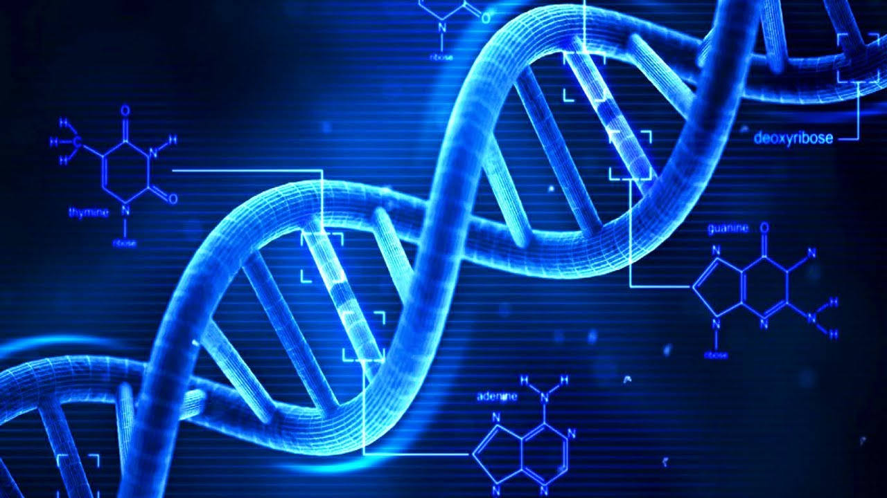
What is DNA?
Deoxyribonucleic acid
Hereditary material in all living organisms
Every cell in a person’s body has the same DNA
Found in the cell nucleus
DNA is packaged tightly into chromosomes
During cell division, DNA unwinds so it can be copied and be used to make proteins
Notes:
https://i.ytimg.com/vi/uXdzuz5Q-hs/maxresdefault.jpg

Slide 12
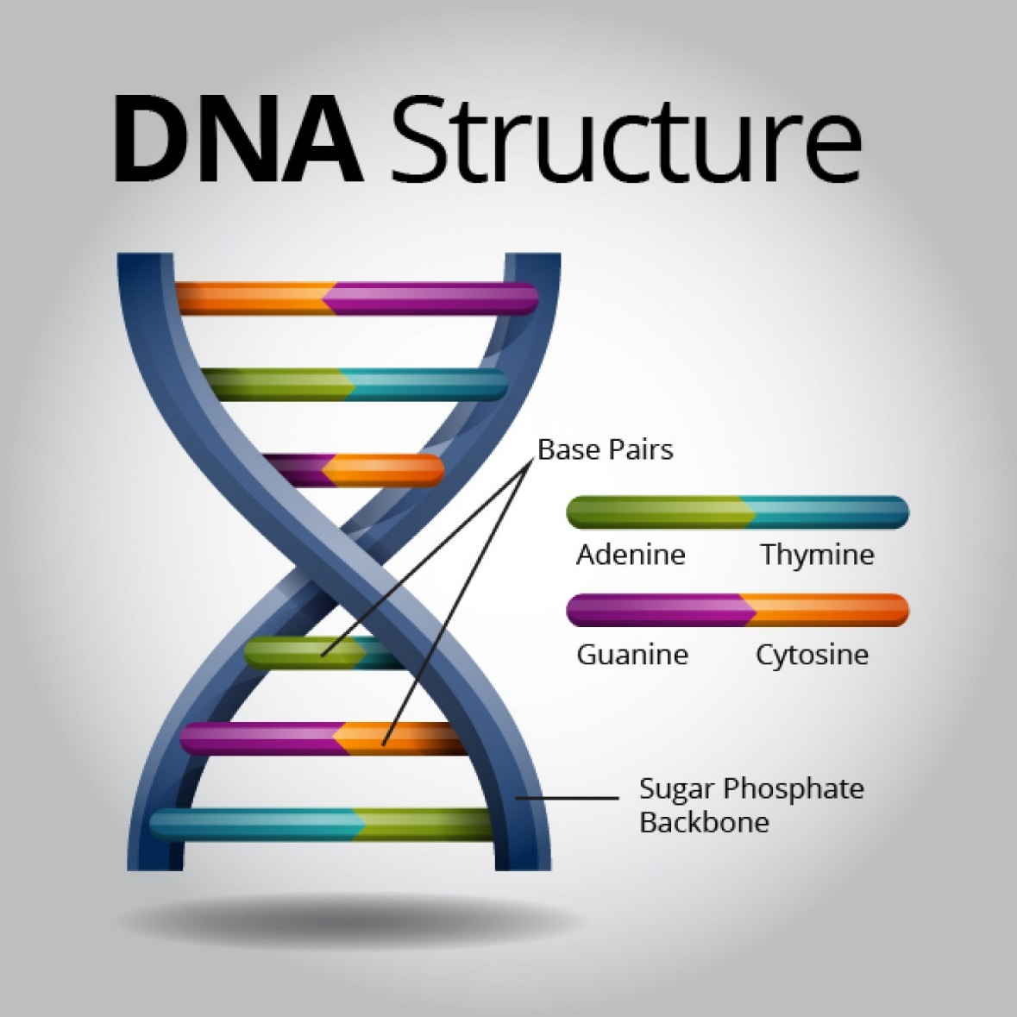
What is DNA?
Information is stored as a code
Adenine (A)
Guanine (G)
Cytosine (C)
Thymine (T)
Human DNA has 3 billion bases (more than 99% are the same between people)
The order, or sequence, of the bases determines the information available for building and maintaining an organism
Notes:
http://www.terravivos.com/images/genome/dnastructure.jpg

Slide 13
What is DNA?
DNA bases pair up with each other
A with T
C with G
CUT the PIE (Pyrimidines)
Each base is attached to a sugar molecule and phosphate molecule
Base + Sugar + Phosphate = Nucleotide
Many nucleotides form 2 long strands that form a spiral called double helix
Notes:
http://www.terravivos.com/images/genome/dnastructure.jpg

Slide 14
Materials
Materials | Quantity
Frozen strawberries | A small handful
Plastic cups | 2
Water | Cup
Shampoo | 2 squirts
Salt | Teaspoon
Cheese Cloth | Amount
Rubbing alcohol | Amount
Plastic Gloves | 2
Wooden Stick | 2
Paper Towels | 3

Slide 15
Procedure
Step 1
Put on gloves and squish the strawberries into one of the plastic cups
Step 2
Add equal volume of water (doesn’t have to be exact)
Step 3
Add 2 small squirts of shampoo and teaspoon of salt. Mix gently with gloves or wooden stick
Step 4
Strain the mixture through a layer of cheesecloth into the second cup. After liquid has dripped through, gently squeeze cheesecloth
Step 5
Add an equal volume of COLD rubbing alcohol to the liquid. Gently swirl the cup or wooden stick
Break open cells
Physically mashing up the produce breaks open the cells. This allows us to access the DNA that is in the nucleus of the cell.
Notes:
List all of the steps used in completing your experiment.
Remember to number your steps.
Include photos of your experiment.

Slide 16
Procedure
Step 1
Put on gloves and squish the strawberries into one of the plastic cups
Step 2
Add equal volume of water (doesn’t have to be exact)
Step 3
Add 2 small squirts of shampoo and teaspoon of salt. Mix gently with gloves or wooden stick
Step 4
Strain the mixture through a layer of cheesecloth into the second cup. After liquid has dripped through, gently squeeze cheesecloth
Step 5
Add an equal volume of COLD rubbing alcohol to the liquid. Gently swirl the cup or wooden stick
Get rid of proteins
Soap (a detergent) and salt breaks open proteins and dissolves the cell membranes. Detergents are used ALL the time to denature or breakdown proteins.
Notes:
List all of the steps used in completing your experiment.
Remember to number your steps.
Include photos of your experiment.

Slide 17
Procedure
Step 1
Put on gloves and squish the strawberries into one of the plastic cups
Step 2
Add equal volume of water (doesn’t have to be exact)
Step 3
Add 2 small squirts of shampoo and teaspoon of salt. Mix gently with gloves or wooden stick
Step 4
Strain the mixture through a layer of cheesecloth into the second cup. After liquid has dripped through, gently squeeze cheesecloth
Step 5
Add an equal volume of COLD rubbing alcohol to the liquid. Gently swirl the cup or wooden stick
Filter unwanted material
Cheese cloth is used to filter out other parts of the cell. Cells are complex and if you only want DNA you need to eliminate the proteins and other cellular components.
Notes:
List all of the steps used in completing your experiment.
Remember to number your steps.
Include photos of your experiment.

Slide 18
Procedure
Step 1
Put on gloves and squish the strawberries into one of the plastic cups
Step 2
Add equal volume of water (doesn’t have to be exact)
Step 3
Add 2 small squirts of shampoo and teaspoon of salt. Mix gently with gloves or wooden stick
Step 4
Strain the mixture through a layer of cheesecloth into the second cup. After liquid has dripped through, gently squeeze cheesecloth
Step 5
Add an equal volume of COLD rubbing alcohol to the liquid. Gently swirl the cup or wooden stick
Precipitate DNA
Alcohol is used to precipitate the DNA. DNA is soluble in water but not alcohol, so by adding alcohol you can see the DNA come out of solution.
Notes:
List all of the steps used in completing your experiment.
Remember to number your steps.
Include photos of your experiment.

Slide 19
Procedure
Step 1
Put on gloves and squish the strawberries into one of the plastic cups
Step 2
Add equal volume of water (doesn’t have to be exact)
Step 3
Add 2 small squirts of shampoo and teaspoon of salt. Mix gently with gloves or wooden stick
Step 4
Strain the mixture through a layer of cheesecloth into the second cup. After liquid has dripped through, gently squeeze cheesecloth
Step 5
Add an equal volume of COLD rubbing alcohol to the liquid. Gently swirl the cup or wooden stick
Notes:
List all of the steps used in completing your experiment.
Remember to number your steps.
Include photos of your experiment.

Slide 20
Follow up Questions

Slide 21
What is DNA, and where is it found?
DNA is the building block of life. It is found in the nucleus of every living cell.
Notes:
Write hypothesis before you begin the experiment. This should be your best educated guess based on your research.

Slide 22
Is there DNA in your food? How do you know?
Yes; we know this because everything we eat was once alive, or made of things that were alive, unless we eat rocks!

Slide 23
If DNA is so small it fits in one cell, how are we able to see it with our eyes after extraction?
We smashed up a LOT of cells, and all the cells have DNA so we isolated a lot of DNA! Like if you tie a bunch of strands of string together to make a rope, you can see it from far away when you couldn’t see an individual piece of string.

Slide 24
What can we do with the DNA we isolate? Why is it valuable that we are able to isolate DNA?
We can use the DNA in forensics (blood, saliva, skin) to solve a crime or to find missing or unknown family members, and test people and food for disease and illness.

Slide 25
Why do we wear gloves when doing science?
We wear gloves for personal protection and often to protect the materials from the oils and DNA on our own hands.

Slide 26
Based on this lab, why do we shampoo when we shower?
Detergents, like soap and shampoo, will be able to break down the grease and dirt built up in our hair.
Notes:
Write hypothesis before you begin the experiment. This should be your best educated guess based on your research.

Slide 27
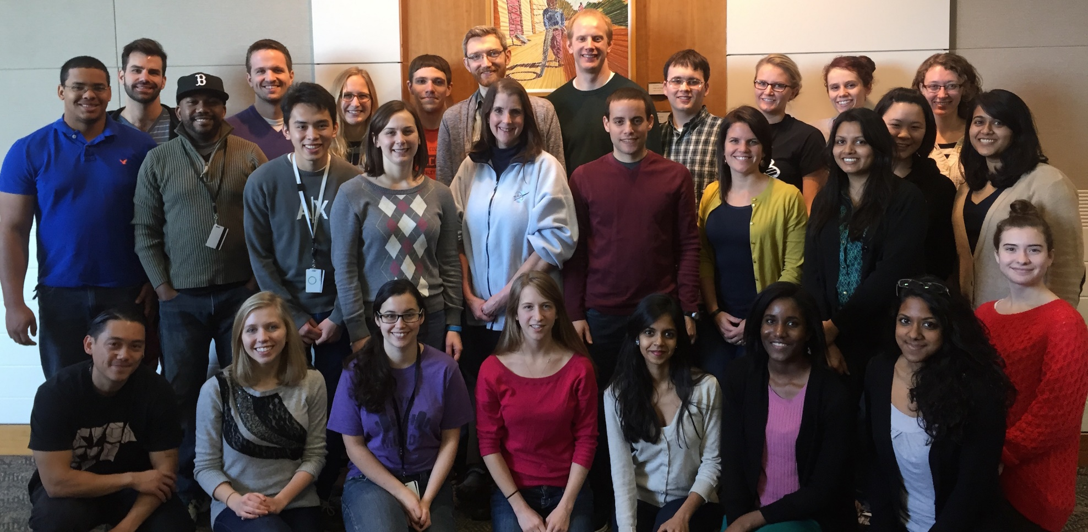
Thank you!!!!
Please fill out our survey.

